Slide 1
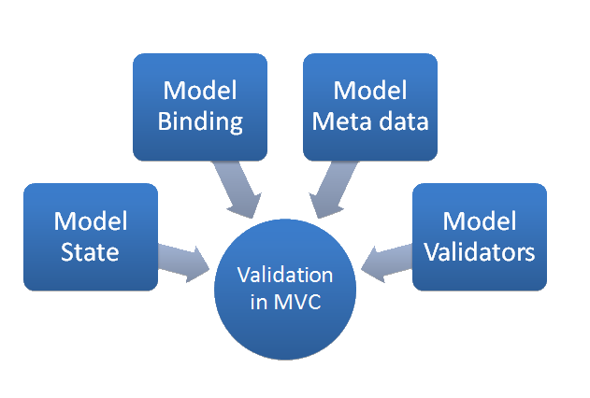


ASP.NET MVC Working with Data
Nikolay Kostov
Team Lead, Senior Developer and Trainer
http://Nikolay.IT
Telerik Software Academy
academy.telerik.com

Slide 2


Table of Contents
Scaffolding
Model Binders
Data Validation
Working with Data Source
Repository Pattern
Unit of Work Pattern

Slide 3
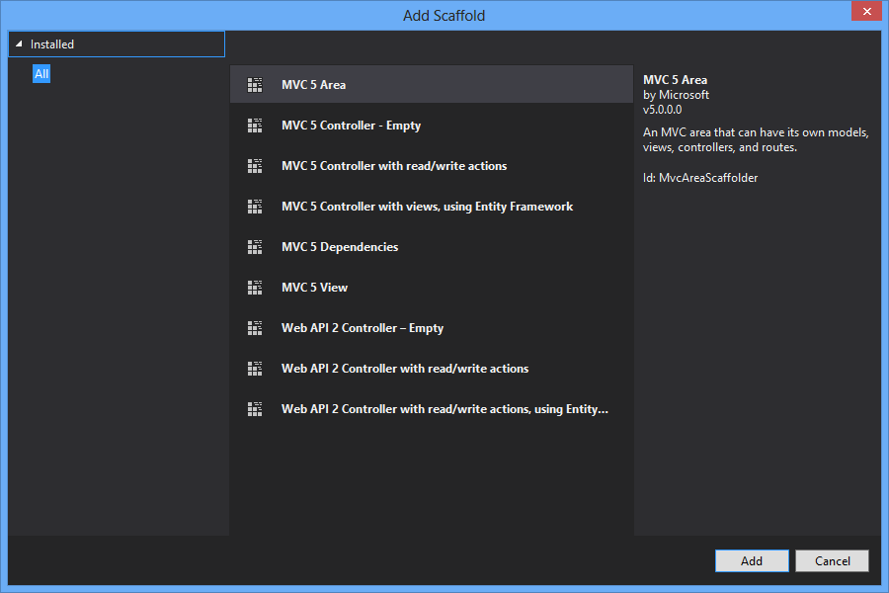
Scaffolding

Slide 4
What is ASP.NET Scaffolding?
Code generation framework for ASP.NET
When you want to quickly add boilerplate code that interacts with data models
Developer productivity enhancer
Can reduce the amount of time to develop standard data operations in your project
Enables customization
Provides an extensibility mechanism to customize generated code
VS 2013 RC includes pre-installed code generators for MVC, and Web API

Slide 5
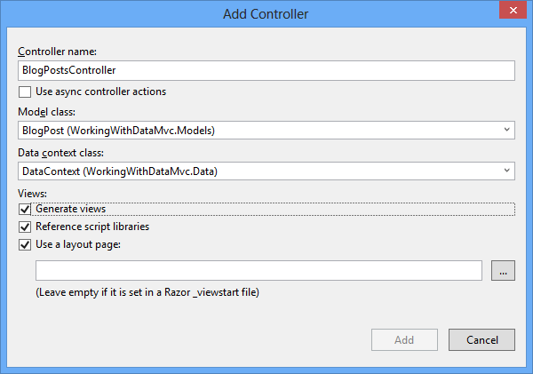
Demo: Create Scaffold
Create Web Forms pages with read/write actions, using Entity Framework

Slide 6

Model Binders

Slide 7
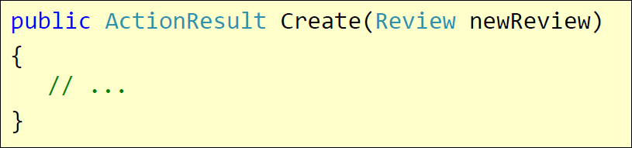
Model Binders
To make easy of handling HTTP post request
Help the populating the parameters in action methods
DefaultModelBinder
HTTP POST /Review/Create
Rating=7&Body=Great!

Slide 8
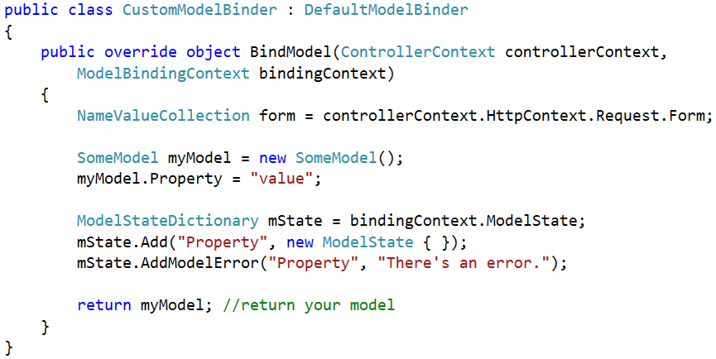
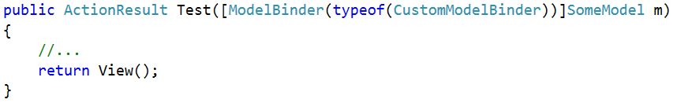
Custom Model Binder

Slide 9

Data Validation

Slide 10
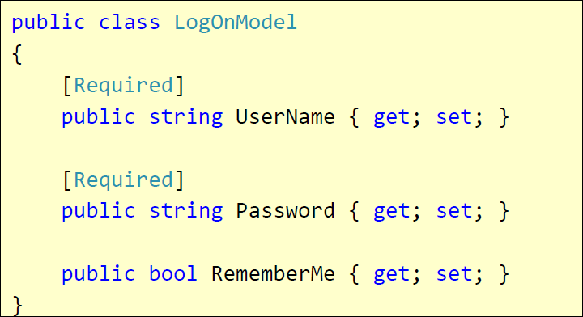
Validation with Annotations
Attributes defined in System.ComponentModel.DataAnnotations
Covers common validation patterns
Required
StringLength
Regex
Range

Slide 11
Data Validation Attributes
Attribute | Description
Compare | Checks whether two specified properties in the model have the same value.
CustomValidation | Checks the value against the specified custom function.
EnumDataType | Checks whether the value can be matched to any of the values in the specified enumerated type.
Range | Checks whether the value falls in the specified range. It defaults to numbers, but it can be configured to consider a range of dates, too.
RegularExpression | Checks whether the value matches the specified expression.
Remote | Makes an Ajax call to the server, and checks whether the value is acceptable.
Required | Checks whether a non-null value is assigned to the property. It can be configured to fail if an empty string is assigned.
StringLength | Checks whether the string is longer than the specified value.

Slide 12
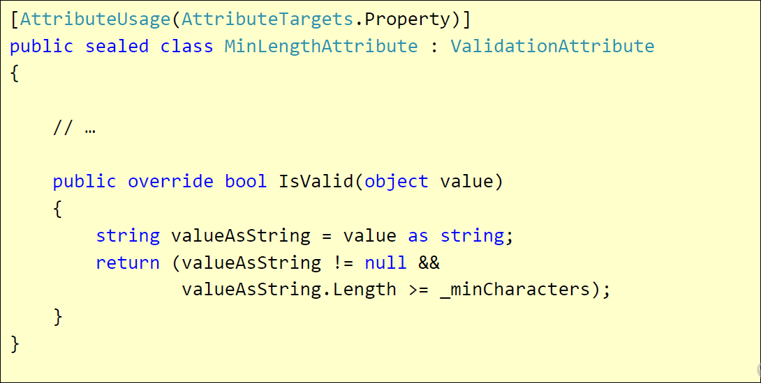
Custom Validation
Custom attributes
Inherit ValidationAttribute

Slide 13
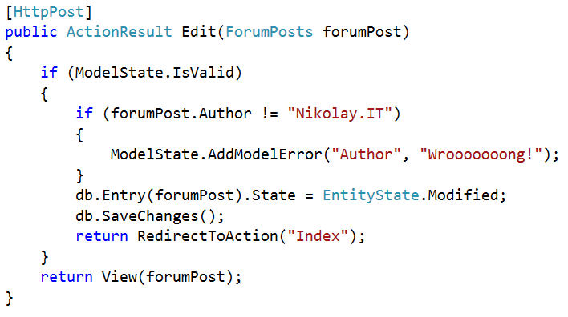
Validating Model – Controller
ModelState.IsValid – will give us information about the data validation success
ModelState.AddModelError – custom error

Slide 14
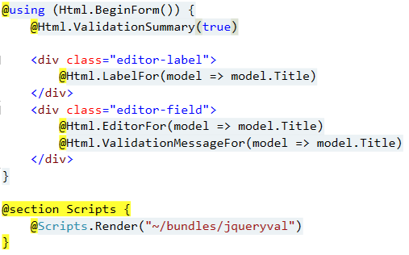
Validating Model – View
@Html.ValidationSummary – output errors
@Html.ValidationMessageFor(…) – outputs validation message for specified property
Text box with integrated client-side validation
jQuery validation library required for unobtrusive JavaScript validation

Slide 15
Display / Edit Annotations
Attribute | Description
DisplayColumn | Specify the property of a model class for simple text display.
HiddenInput | Render value in a hidden input (when editing).
UIHint | Specify the name of the template to use for rendering.
DataType | Common templates (email, password, URL, currency)
ReadOnly | Specify a read-only property (for model binding).
DisplayFormat | Format strings and null display text
ScaffoldColumn | Turn off display and edit capabilities
DisplayName | Friendly name for labels

Slide 16

Working with Data Source
Repository pattern and Unit of Work pattern

Slide 17
Repository Pattern
Separate business code from data access
Separation of concerns
Testability
Encapsulate data access
Increased level of abstraction
More classes, less duplicated code
Maintainability, Flexibility, Testability
Generic repositories
IRepository<T>

Slide 18
Repository Pattern (2)
Business & Domain Logic
Exchange Rates Repository
Blog Posts Repository
Settings Repository
Web Service
SQL Database
File

Slide 19
Unit of Work
Track changes in persistent objects
Efficient data access
Manage concurrency problems
Manage transactions
Keep business logic free of data access code
Keep business logic free from tracking changes
Allow business logic to work with logical transactions

Slide 20
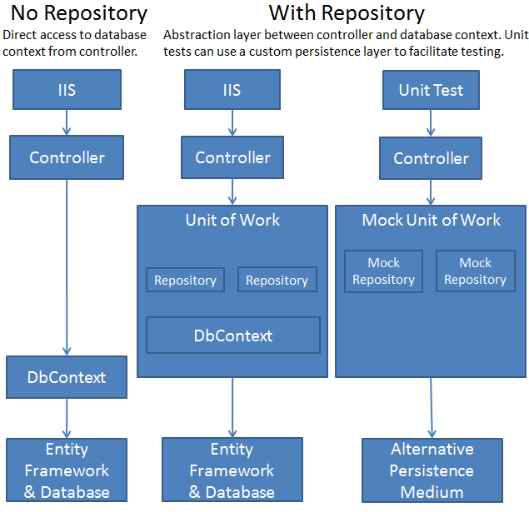
Repository and UoW Patterns in an ASP.NET MVC Application

Slide 21
ASP.NET MVC Working with Data
http://academy.telerik.com

Slide 22
Homework
Create a simple ASP.NET MVC Twitter-like system using data validation, Entity Framework, repository pattern and unit of work pattern. Your system should:
Have users and administrators
List all tweets for specific user in his profile
List all tweets containing specific tag (#fail) and use 15 minutes caching for each tag
Have administration for the tweets using ASP.NET scaffolding (admins only)
* Have Kendo UI Grid-based administration for tweets (with paging, sorting, filtering, etv.)

Slide 23



Free Trainings @ Telerik Academy
“C# Programming @ Telerik Academy
csharpfundamentals.telerik.com
Telerik Software Academy
academy.telerik.com
Telerik Academy @ Facebook
facebook.com/TelerikAcademy
Telerik Software Academy Forums
forums.academy.telerik.com

